Slide 1
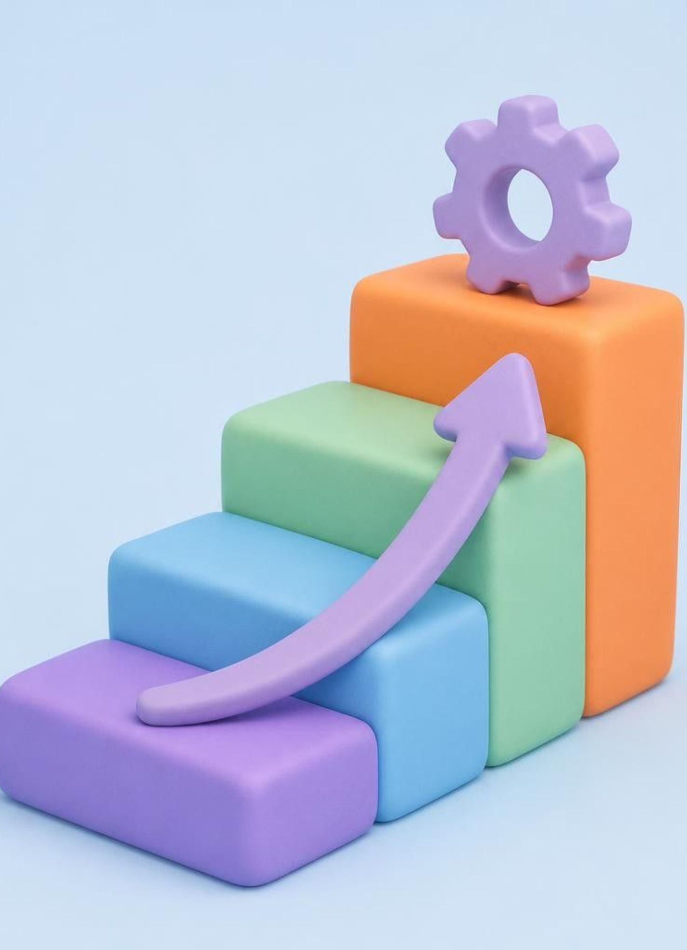




WATERFALL MODEL
Waterfall builds software in a fixed sequence
1. What it is
A traditional SDLC model where each phase completes before the next begins.
2. Example
An HR system like OrangeHRM with login, employee management, leave management, and dashboard.
3. Key features
Simple fixed sequence; clear requirements documented early; detailed documentation; easy progress tracking.
4. Remember
Requirements → Design → Development → Testing → Deployment → Maintenance.
Notes:
Introduce the Waterfall model as a structured, sequential framework where every step must finish before the next one starts.

Slide 2
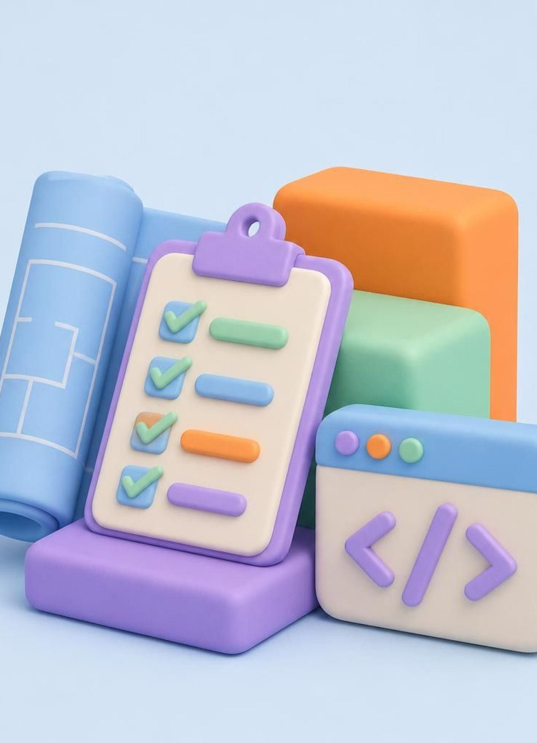



WATERFALL MODEL
Phases 1-3: Plan it, design it, build it
1. Requirements Analysis
document what the customer needs. Example: login, employee details, leave requests. Output: SRS
2. System Design
plan architecture, database, screens. Example: login screen, employee database, dashboard layout. Output: design documents
3. Development
code from the approved design. Example: authentication, leave management. Output: developed software
Notes:
Walk through the first half of the lifecycle: gathering expectations, architecting the blueprint, and writing the application code.

Slide 3
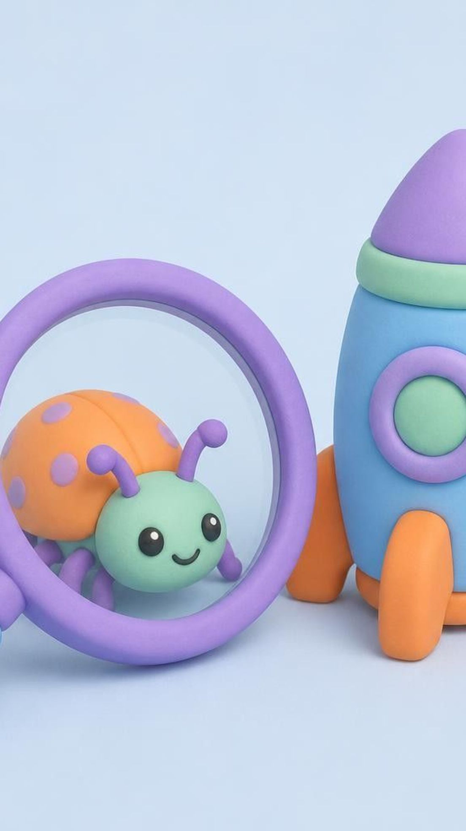
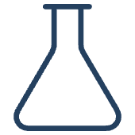

WATERFALL MODEL
Phases 4-6: Verify it, release it, keep it healthy
4. Testing
Find defects, verify requirements. Example: valid and invalid login, required-field checks. Output: test and defect reports.
5. Deployment
Release for real use. Example: HR app goes live for HR team and employees. Output: released software.
6. Maintenance
Fix and update after release. Example: fix a leave-balance calculation. Output: bug fixes and updates.
Notes:
Explain how quality assurance, deployment, and ongoing maintenance conclude the lifecycle once the build phase is complete.

